Slide 1
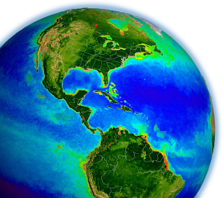
SeaDAS lab
Jeremy Werdell
Sean Bailey
NASA Goddard Space Flight Center
UMaine Ocean Optics Summer Course
July 10 – Aug 4 2017
Acknowledgements: Aynur Abdurazik, Matt Elliot, Danny Knowles, & Don Shea

Slide 2
by the end of this lab, we hope you will …
understand the organization & flow of satellite ocean color data
be comfortable with SeaDAS & without fear of breaking it

Slide 3
what is SeaDAS?
SeaWiFS Data Analysis System (SeaDAS)
http://seadas.gsfc.nasa.gov
http://oceancolor.gsfc.nasa.gov
image analysis package for processing, displaying, analyzing, & QC’ing satellite ocean color data
available for use with all NASA Ocean Biology Processing Group (OBPG) supported sensors: MODIS-Aqua & -Terra, SeaWiFS, OCTS,& CZCS, plus VIIRS, MERIS, HICO, OLI
general scientific imagery & data analysis package

Slide 4
why SeaDAS?
conceived of to fill a need in the post-CZCS, pre-SeaWiFS era when common tools did not exist to:
- display satellite ocean color data
- reproduce (& refine) the operational NASA products
still uncommon for agencies to distribute source code to replicate operational satellite data processing

Slide 5
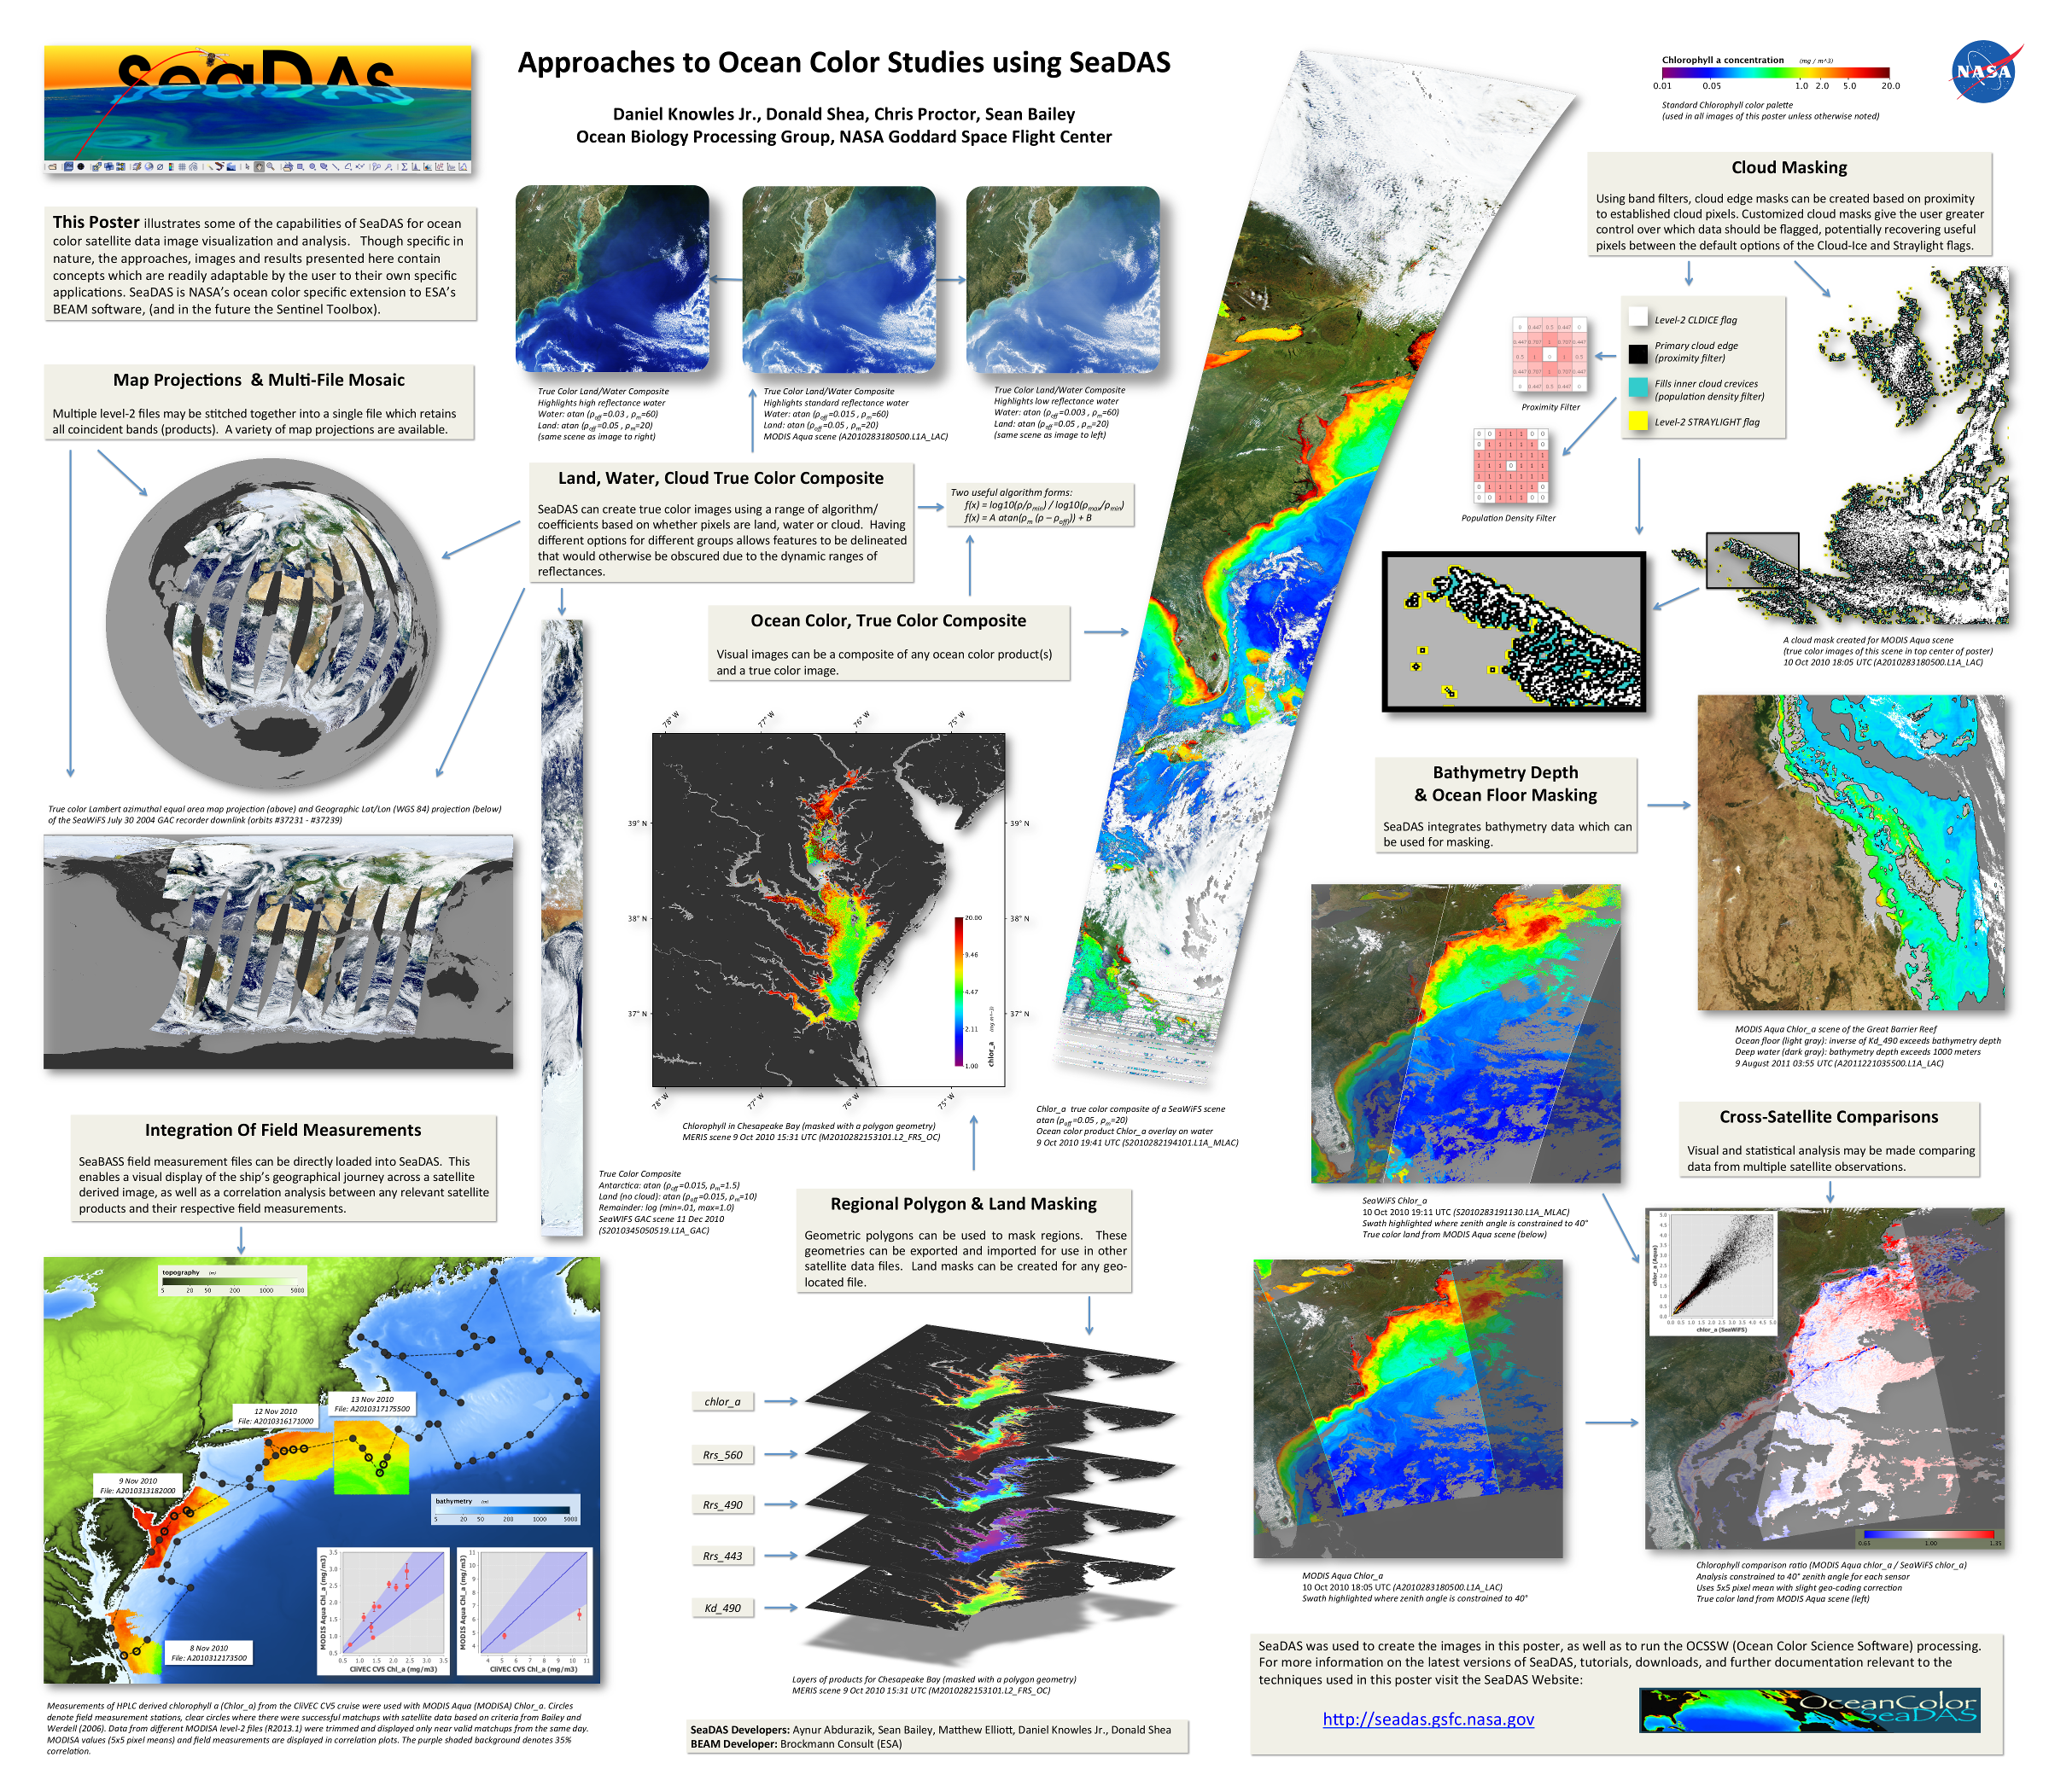
SeaDAS: What’s in the box…
SeaDAS uses a module-based architecture
Modules/Tools
Image View
File Manager
Layer Manager
Mask Manager
Collocation Tool
Mosaic Tool
Map Projection Tool
GeoCoding Tool
Statistics Tools
Math Band Tool
Filter Band Tool

Slide 6
It’s a big box …
NASA’s Ocean Biology Processing Group Science processing software
Custom Data File Readers (more than 15 specific satellites supported)
Coastline and Land Mask Module
Bathymetry Module
Contour Line Module
Ship Track & SeaBASS
Band (image) Filters
RGB Profiles
Color Manager
Color Bar
Map Gridlines
Internal Help Pages

Slide 7
lab organization
morning lecture: introduction & bookkeeping
afternoon lecture: satellite data processing
instructor-led demonstrations on:
- the SeaDAS environment & visualizing data
- flags & masks
- data analysis tools
- satellite data processing
- comparing satellite & in situ measurements
student exercises following each demonstration

Slide 8
has anyone used SeaDAS before?

Slide 9
satellite ocean color
the satellite views the spectral light field at the top-of-the-atmosphere
SATELLITE
TOP-OF-THE-ATMOSPHERE
1. remove atmosphere from total signal to derive estimate of light field emanating from sea surface (remote sensing reflectance, R_{rs})
3. spatially / temporally bin and remap satellite C_{a} observations
SEA SURFACE
2. relate spectral R_{rs} to C_{a} (or geophysical product of interest)
PHYTOPLANKTON

Slide 10
SeaDAS infrastructure
visualization GUI (graphical user interface) written in Java
wrapper scripts written in Python (modis_GEO.py, etc.)
source code (l2gen, l3bin, etc.) written in C & Fortran
same code used in production at GSFC

Slide 11
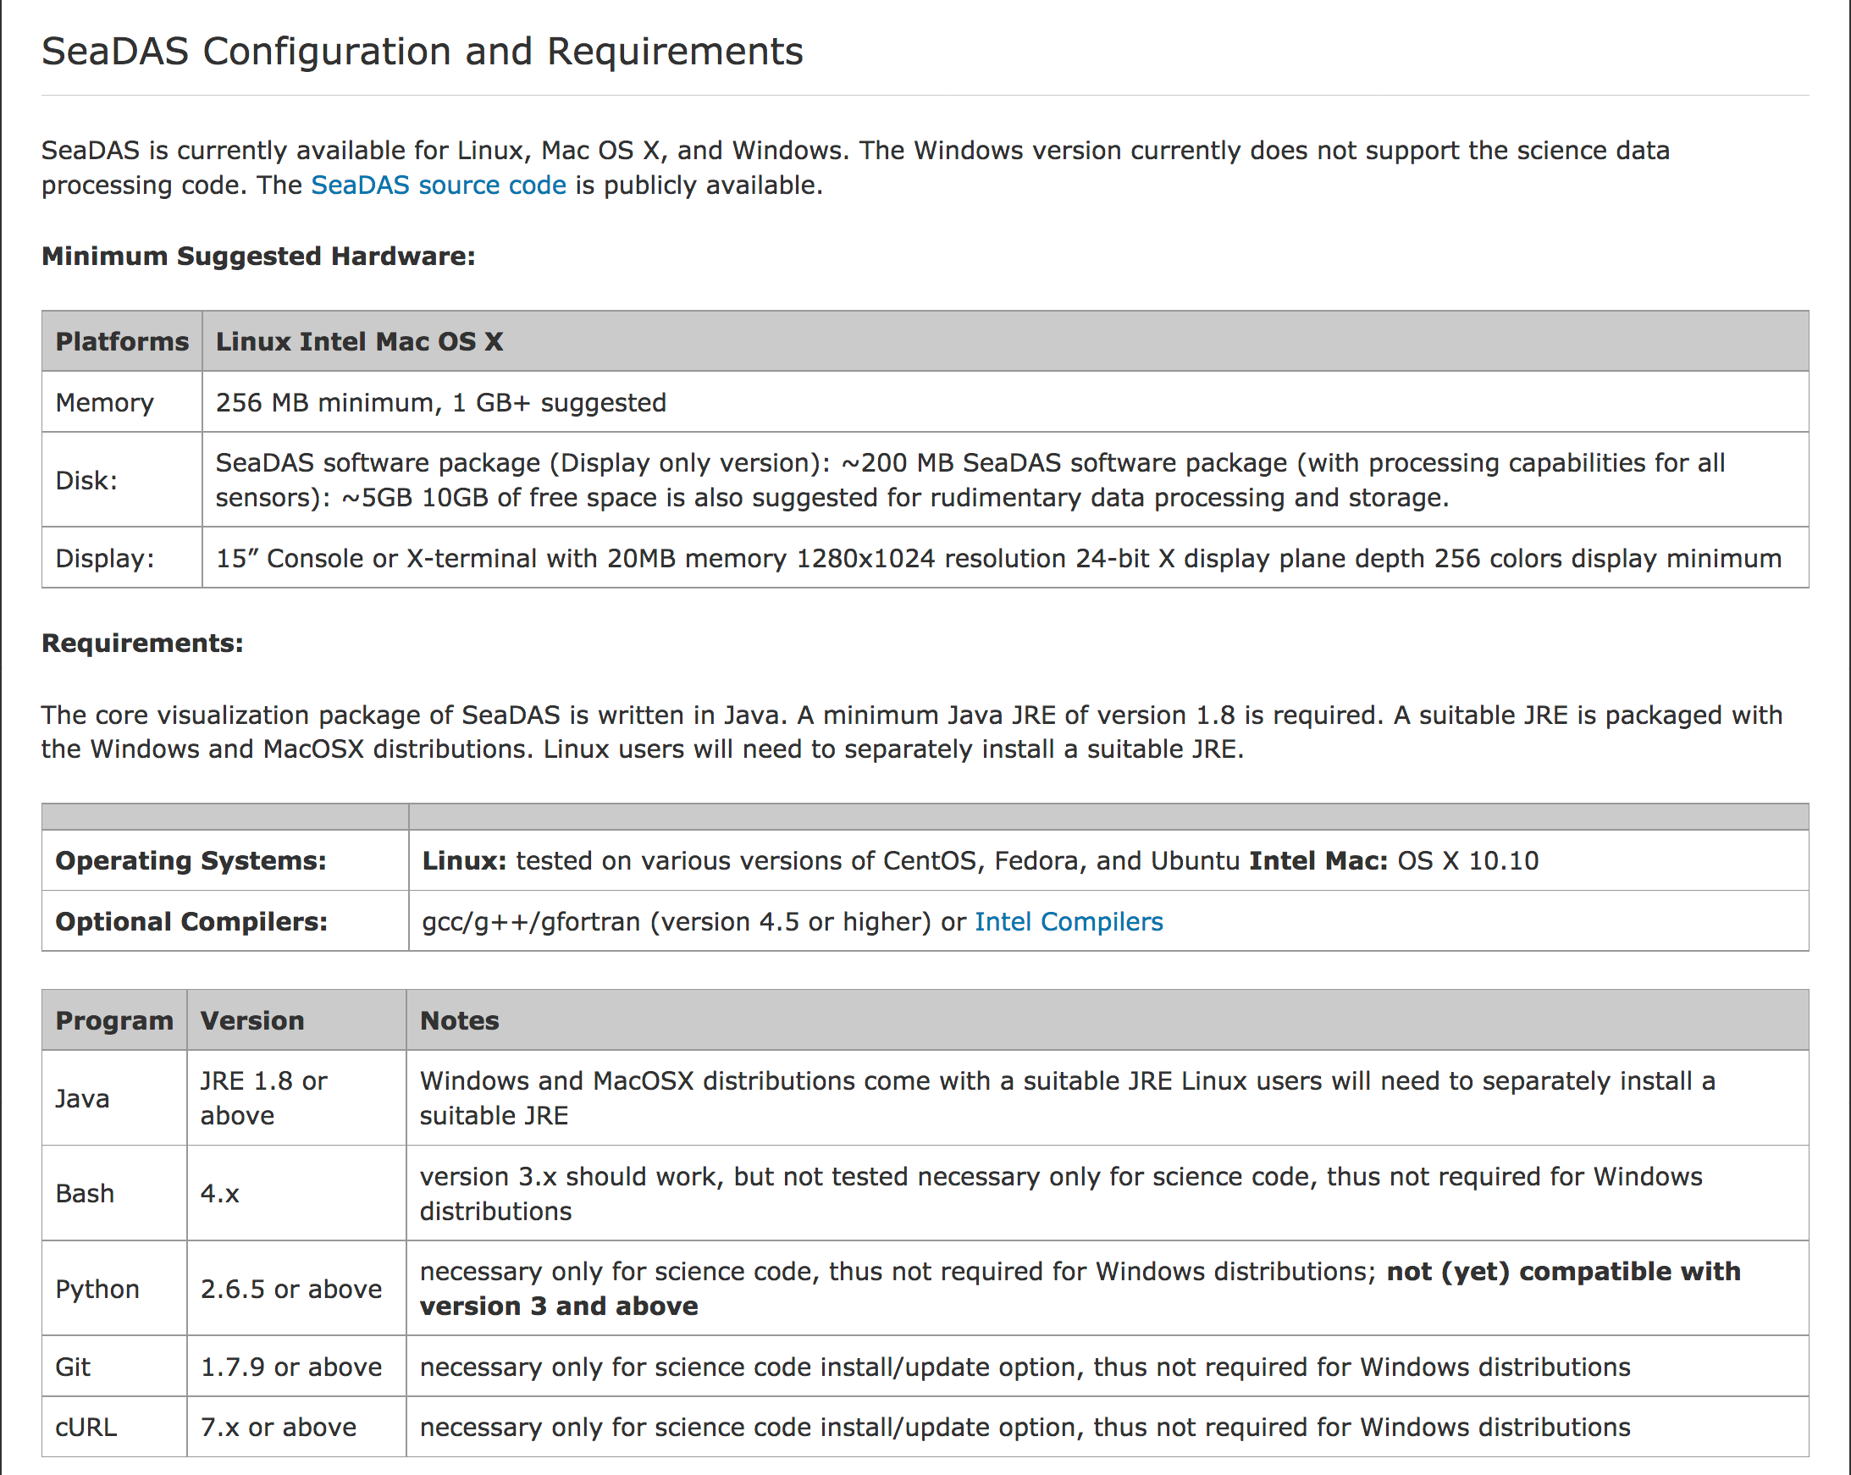
requirements

Slide 12
satellite ocean color file formats
HDF & netCDF
http://www.hdfgroup.org/
http://www.unidata.ucar.edu/software/netcdf/
self-describing & machine independent file structure
layers of array-oriented data proceeded by global attributes that describe the data & provide metadata

Slide 13
SeaDAS resources
SeaDAS Web site – online help & instructions
http://seadas.gsfc.nasa.gov
OceanColor online forum – SeaDAS-specific boards
http://oceancolor.gsfc.nasa.gov/forum/oceancolor/forum_show.pl
SeaDAS 7 interactive help (buttons within the GUI)
email
seadas@seadas.gsfc.nasa.gov
YouTube

Slide 14
lecture break

Slide 15
MODIS data levels & flow
Level 0
raw digital counts
native binary format
ATT & EPH
spacecraft attitude
spacecraft position
Level 1A
raw digital counts
HDF formatted
GEO
geolocation
radiant path geometry
Level 1B
calibrated reflectances
converted telemetry
ancillary data
wind speed
surface pressure
total ozone
Reynolds SST
Level 2
geolocated geophysical products for each pixel

Slide 16
satellite ocean color
the satellite views the spectral light field at the top-of-the-atmosphere
SATELLITE
everything up to Level-1B
TOP-OF-THE-ATMOSPHERE
1. remove atmosphere from total signal to derive estimate of light field emanating from sea surface (remote sensing reflectance, R_{rs})
3. spatially / temporally bin and remap satellite C_{a} observations
Level-3
SEA SURFACE
Level-2
2. relate spectral R_{rs} to C_{a} (or geophysical product of interest)
PHYTOPLANKTON

Slide 17
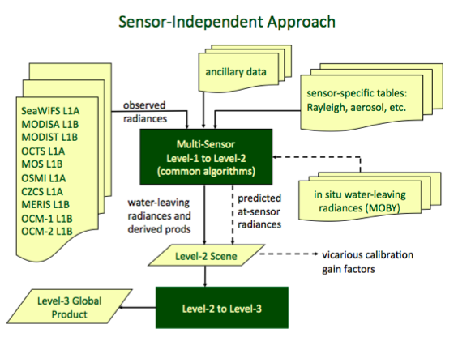
Level-2 processing (l2gen)
common software for Level-2 processing of MODIS, SeaWiFS, MERIS, & other sensors in a consistent manner
supports a multitude of product algorithms and processing methodologies
standard products
evaluation products
user defined products
run-time selection

Slide 18
as data is processed by l2gen from Level 1 to Level 2, checks are made for different defined conditions when certain tests and conditions are met for a given pixel, a flag is set for that pixel for that condition a total of 31 flags can be set for each pixel these l2gen processing flags are stored in the Level 2 data file as the "l2_flags" product the storage method sets bits to 0 or 1 in 32-bit integers that correspond to each pixel
Level-2 processing (l2gen)

Slide 19
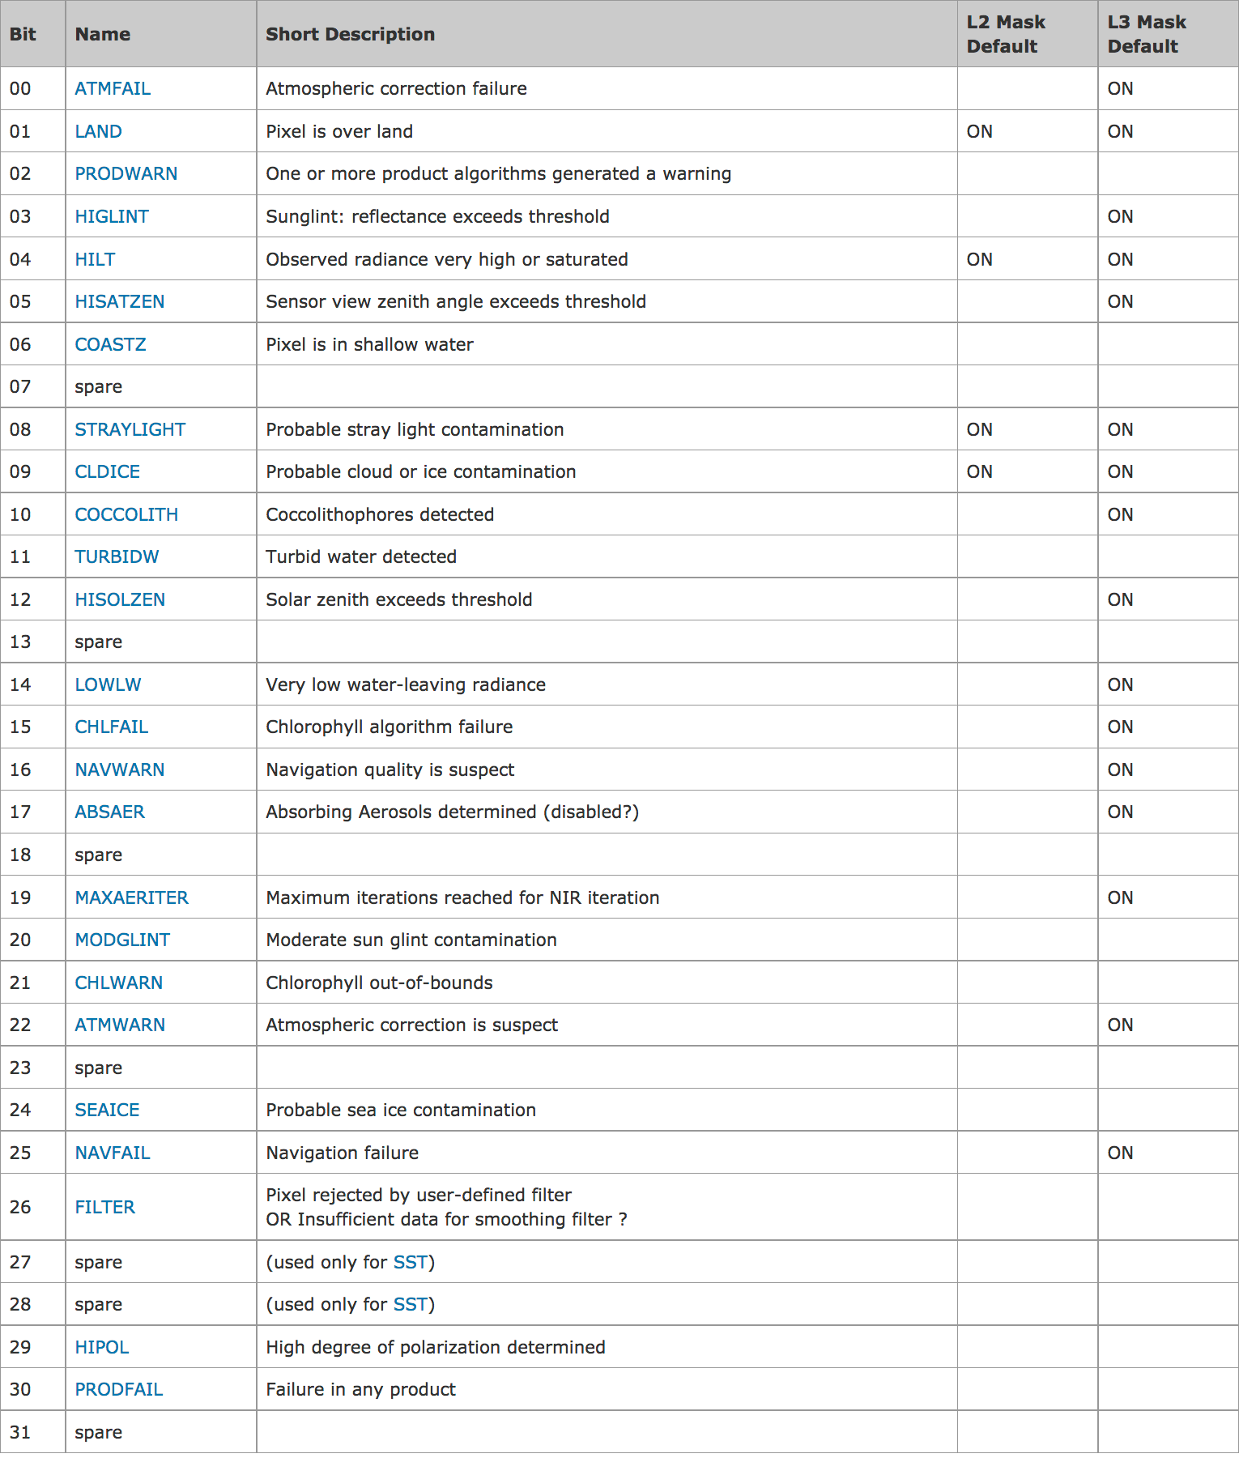
Level-2 processing flags
(flags in red are masked during Level 3 processing)

Slide 20
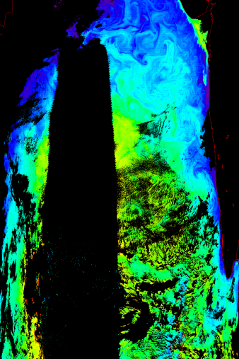
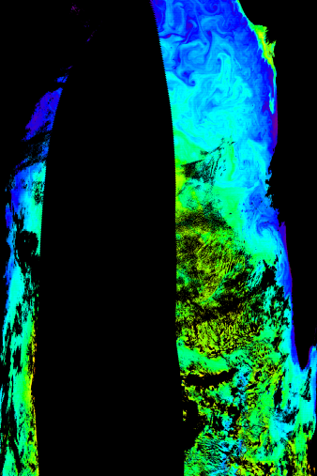
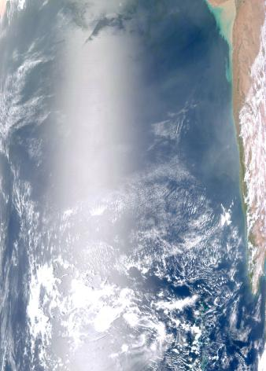
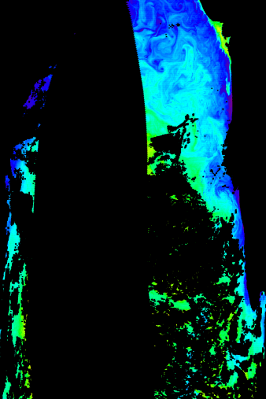
Level-2 flags & masks
RGB Image
nLw (443)
sediments
glint
cloud
add masking for high glint
add masking for straylight
Notes:
Only masking is for clouds
Physical saturation, no retrieval
Can eliminate or change cloud masking, but can’t change saturation
Chlorophyll looks good, even near in glint (band ratio) What about radiances?

Slide 21
satellite ocean color
the satellite views the spectral light field at the top-of-the-atmosphere
SATELLITE
TOP-OF-THE-ATMOSPHERE
1. remove atmosphere from total signal to derive estimate of light field emanating from sea surface (remote sensing reflectance, R_{rs})
3. spatially / temporally bin and remap satellite C_{a} observations
SEA SURFACE
2. relate spectral R_{rs} to C_{a} (or geophysical product of interest)
PHYTOPLANKTON

Slide 22
MODIS Level-3 processing
Level 2
geolocated geophysical products for each pixel
Bin resolution 4.6 x 4.6 km²
Mapped resolution
0.042-deg
0.084-deg
Composite Periods
Daily
8-day
Monthly
Seasonal
Yearly
Mission
Level 3 binned
geophysical products averaged spatially and/or temporally
sinusoidally distributed, equal area bins
Level 3 mapped
images created by mapping and scaling binned products
user-friendly, cylindrical equiangular projection

Slide 23
Level-3 terminology
projection - any process which transforms a spatially organized data set from one coordinate system to another
mapping - process of transforming a data set from an arbitrary spatial organization to a uniform (rectangular, row-by-column) organization, by processes of projection & resampling
binning - process of projecting & aggregating data from an arbitrary spatial & temporal organization to a uniform spatial scale over a defined time range

Slide 24
ocean color projections
equal-area - sinusoidal with equally space rows & number of bins per row proportional to sine of latitude
equal-angle - rectangular (Platte Carre) with rows and columns equally spaced in latitude and longitude
equal-area & -angle projections are equivalent at the equator

Slide 25
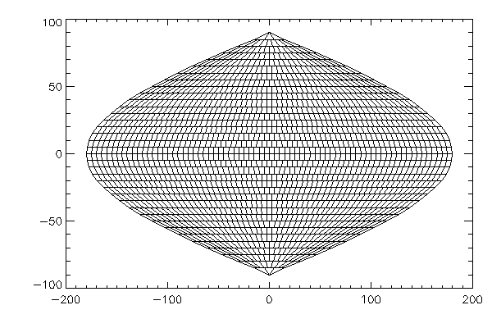
sinusoidal equal area projection

Slide 26
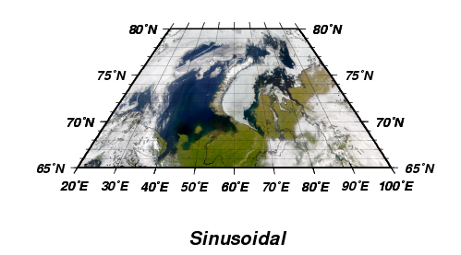
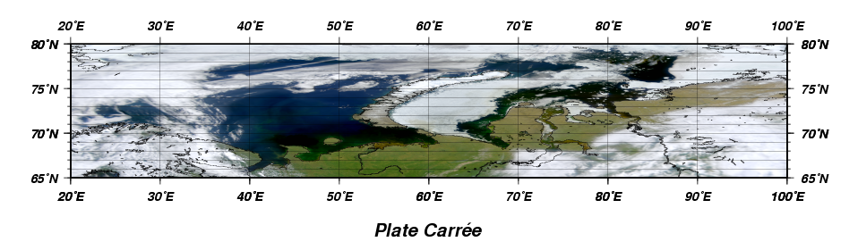
Level-3 binned vs. mapped
bin file grid
bin files
multiple products
stored as float
sampling statistics included
map files
single product
stored as scaled integer
map file grid

Slide 27
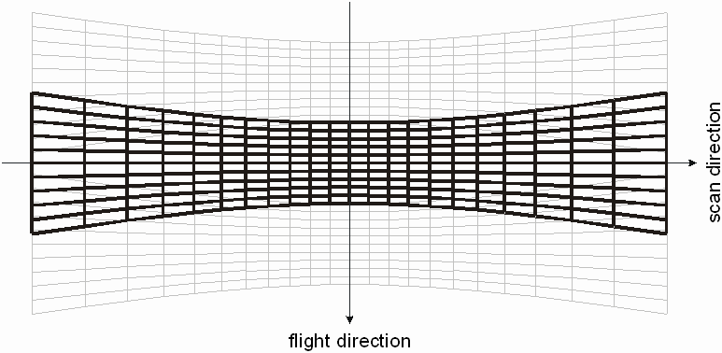
MODIS “bow-tie” effect
Increasing Pixel Size

Slide 28
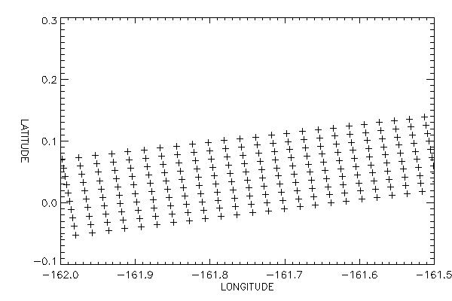
one MODIS scan at ~45 degrees scan angle

Slide 29
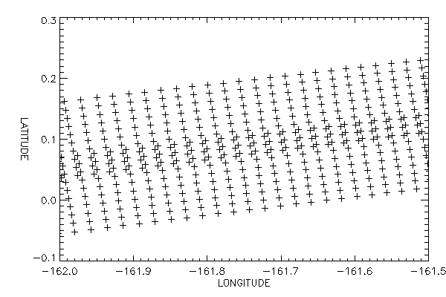
two MODIS scans showing overlap of pixels

Slide 30
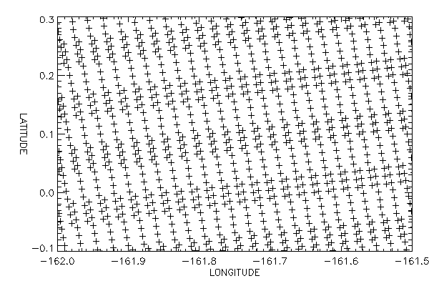
multiple MODIS scans showing pixel overlap

Slide 31
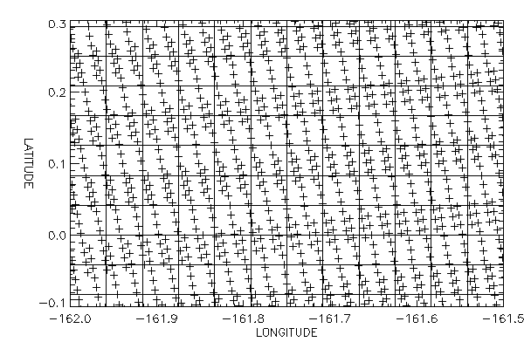
bin boundaries overlaid on pixel locations

Slide 32
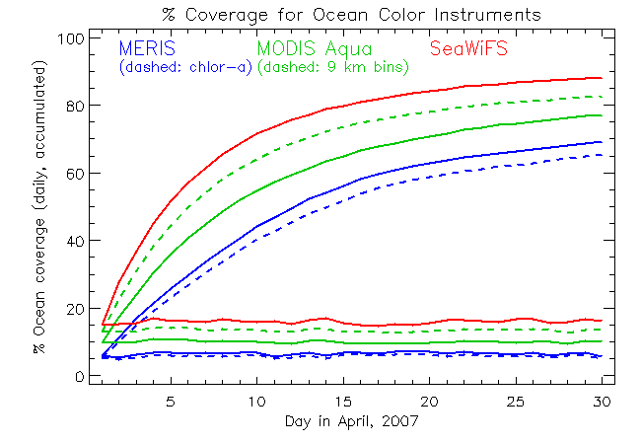
ocean coverage over time for binned files

Slide 33
lecture break

Slide 34
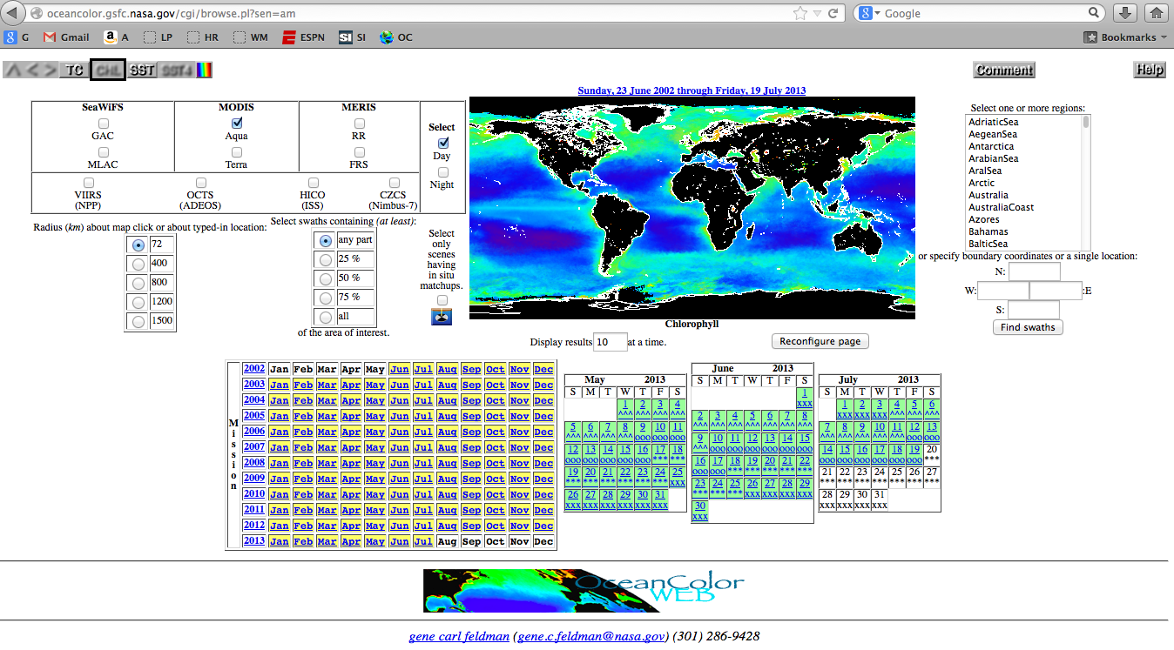
acquiring ocean color data
http://oceancolor.gsfc.nasa.gov/cgi/browse.pl

Slide 35
BACKUP

Slide 36
SeaDAS development timeline
conceived of in the mid-1990’s, referred to as “SeaPAK”
renamed “SeaDAS” circa the launch of SeaWiFS in 1997
stimulated development of the ESA BEAM software package to visualize ENVISAT (MERIS) data products circa 2002
awarded NASA Software of the Year in 2003
built on an IDL (Interactive Data Language) infrastructure through June 2012 (version 6.4)
recast as an integrated tool with the ESA BEAM software package in Spring 2013 (version 7)

Slide 37
SeaDAS 7
collaboration with BEAM (Brockmann Consult, Germany)
- look & feel of BEAM
- functionality & processing capabilities of SeaDAS 6.4
officially released in April 2013
we will break something at some point today – this is ok
you will have questions that I cannot answer – this is also ok

Slide 38
BEAM & SeaDAS: Cross usability
File Inter-Compatibility
A file/session may be saved from SeaDAS and loaded into BEAM*
A file/session may be saved from BEAM and loaded into SeaDAS
Pick One (then use the other when …)
FEATURES: … it contains a feature you need
BUGS: … it does not contain a bug impeding you
Help
Forum – check both
Internal Help – check both
Videos – Many SeaDAS YouTube videos are (indirectly or directly) applicable to BEAM
* Some minor SeaDAS specific added metadata could get lost.

